Slide 1
E-commerce Platform Performance Analyze

Slide 2
agenda
Introduction
Order by category
Monthly order trends
Most common complain reasons
Delivery delay distribution
Complaint by category
Return vs Complaint
Return rate
Conclusion

Slide 3

Introduction
This analysis explores customer orders, returns, and complaints from an e-commerce platform.
We use data-driven insights to assess sales trends, delivery performance, and customer behavior.
The goal is to identify key issues and growth opportunities to improve operations and customer satisfaction.

Slide 4
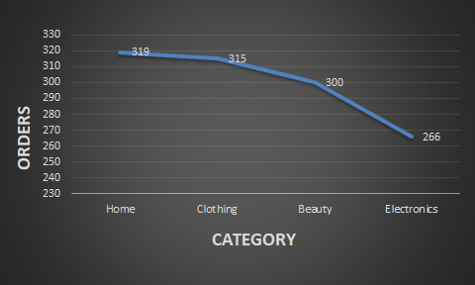
Order by category
The Home and Clothing categories have the highest order volumes, reflecting strong customer demand.
Electronics is the least ordered category, indicating a possible need to reassess product offerings or marketing.

Slide 5
Monthly order trends
Monthly orders dropped steadily from 225 in December 2024 to just 157 in February 2025, indicating reduced customer engagement.
Major Drop in August 2024 is only 20, signaling a possible issue like system downtime, stock unavailability, or seasonal dip.

Slide 6
Most common complain reasons
Late Delivery Dominates 40% of all complaints are due to Late Delivery, making it the most critical issue affecting customer satisfaction.
Only 10% of complaints relate to Customer Service, indicating fewer concerns with support interactions compared to delivery and product issues.

Slide 7
Delivery delay distribution
Out of all orders, 609 were delivered on time, reflecting overall efficiency in logistics.
A combined 591 orders faced delays (356 slight, 235 long), showing room for improvement in delivery performance.
Delivery on the same day (0 days) is On Time, within 2 days is a Slight Delay, and more than 2 days is a Long Delay.

Slide 8
complaint by category
Late Delivery has the highest number of complaints in all product categories.
Customer Service Issues have the lowest complaint counts across all categories.
Damaged Product complaints are highest in Beauty but drop in other categories.
Wrong Item issues are significantly high in Clothing and Home categories

Slide 9
return vs complaint
Late Delivery has the highest number of return requests (75).
Damaged Product is the second most reported issue, with 50 return requests.
Wrong Item and Customer Service Issue have fewer return requests compared to the other reasons.

Slide 10
Return rate
Beauty category has the highest return rate at 18.33%.
Clothing has the lowest return rate at 10.48%.
Electronics and Home categories have moderate return rates at 16.17% and 14.73%, respectively.

Slide 11

Conclusion
Home & Clothing are the most ordered categories; Electronics has the lowest demand.
Order volumes are declining, with a sharp drop seen in August 2024.
Nearly 50% of orders face delays, suggesting logistics improvements are needed.
Late Delivery (40%) is the top complaint, followed by Damaged Products (27%).

Slide 12
Thank you

